Slide 1
Performance Based Navigation Approval and Training

Slide 2
Contents
PBN Background
Certification Basics
PBN Basics
Navigation Databases
GNSS in PBN
Navigation Specifications
CAO 20.91
Navigation authorisations

Slide 3
PBN Terminology
Correct terminology is important for clarity:
Area Navigation is the generic term used for area navigation and is never abbreviated.
RNAV is used only in reference to RNAV specifications.
RNP is used only in reference to RNP specifications.

Slide 4
Airspace Fundamentals
Airspace capacity is determined by the separation standard applied.
Minimum separation is a function of the CNS and ATM system capabilities.
All four elements require a regulatory infrastructure defining requirements and standards.

Slide 5
Operational Approvals
Operational Approvals are the key to the implementation of the emerging air navigation system.
Without operational approvals, operators will not be able to take advantage of the emerging technologies.
An operational approval is about:
An OPERATOR
Conducting that OPERATION
With that AIRCRAFT
In that AIRSPACE

Slide 6
Operational Approval Content
Head of Power
Requirements
Standards
Authority
Operational Approval
Airworthiness
Continued Airworthiness
Flight Operations
Aircraft requirements:
Function & Performance
Installation
Design standards
Maintenance schedule
Configuration management
Maintenance procedures
Parts
Test equipment
Training
Syllabus
Competency
Operating procedures
Route Guide
MEL
Training
Syllabus
Means of delivery
Competency
Continued competency
Regulator Infrastructure
Certification procedures
Business systems
Training
Competency

Slide 7
Airworthiness
Compliance with airworthiness requirements must be determined.
Approval is at the aircraft level.
Includes equipment and the aircraft installation.
New production aircraft have airworthiness approvals identified in the AFM and / or OEM Service Letter.
Airworthiness approval is usually straightforward.
Legacy aircraft require more detailed analysis.
Compliance with requirements may require detailed certification activity.
Tier 3+ aircraft modification configuration can be a problem.
Some approvals are addressed by OEM Service Bulletin.

Slide 8
Continued Airworthiness
Each operator is responsible for ensuring that each aircraft is maintained compliant with its type design.
Continued airworthiness elements that must be addressed:
Maintenance schedule.
Configuration management, particularly software & electrical load analysis.
Maintenance procedures.
Parts.
Test Equipment.
Training & competency.

Slide 9
Flight Operations
Flight operations element must address:
Operating procedures.
Route Guide.
Minimum Equipment List.
Crew training.
Includes the syllabus and delivery methods.
Training requirements are included in ACs.
Simulator exercises.
Crew competency.
Continuation training and currency.

Slide 10
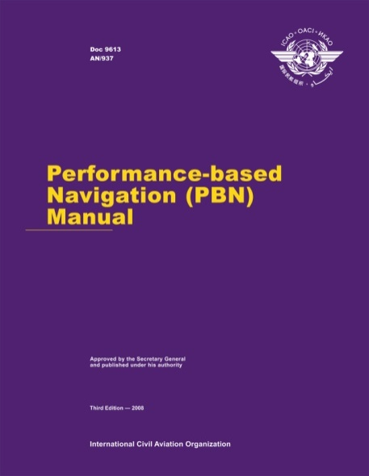
PBN Regulatory Structure
CAO 20.91 App 4 para 12.2 (r):
Perform gross error checks.
AC 91.U-II-1(0):
Training programme
Handbook C3.2.2:
Crew training & competency
CAO 20.91
Instructions and directions for PBN
Worksheet Line 75:
Crew operating procedures – perform gross error checks.
AC 91.U-II-1(0)
Navigation Authorisations
Assessors Handbook
CAO 20.18
Aircraft equipment – basic operational requirements
Assessors Worksheet

Slide 11
Navigation Authorisations Process
Australia is implementing a navigation authorisation system that addresses all authorisations required in a single application.
Certification activity is focussed on operator first-of-type applications.
An application can be revised for additional authorisations and aircraft.
Authorisation changes focus on differences.
The applicant must demonstrate compliance.
Installation design engineers need to consider the operational requirements in system installation designs.
Flight Manual Supplements need to clearly state operational limitations in the Limitations section.
AFMS commonly state that an aircraft is approved for an operation; this indicates an airworthiness approval only.

Slide 12
Navigation Authorisation Process
Operator completes the application form 1307 to demonstrate compliance with the relevant requirements.
Application and substantiating data is submitted to the CASA for approval.
When approved, the operator Op Spec will be revised or an navigation authorisation instrument issued.

Slide 13
Certification Basics

Slide 14
Typical Navigation System

Slide 15
Hierarchy of Requirements
Operational Requirements
System requirements
Regulatory requirements
Derived requirements
Sub-system requirements
Regulatory & derived requirements
Hardware requirements
Regulatory & derived requirements
Software requirements
Regulatory & derived requirements

Slide 16
4 C’s and 3 A’s
Configuration
Conformance
Compliance
Certification
Approved
Accepted
Authorised

Slide 17
Similarity
Compliance can be demonstrated by similarity with other aircraft or installations.
To be acceptable, the basis of the similarity must be defined and be valid (relevance and applicability test):
The subject being considered for similarity must be:
Relevant to the aircraft / system / configuration under consideration.
Applicable to the aircraft / system / configuration under consideration.

Slide 18
Navigation databases

Slide 19
Database Management
The PBN Manual requires operators to use current databases.
Operators should have processes for managing navigation databases to ensure aircraft are always using current data.

Slide 20
Database Integrity
The PBN Manual requires navigation data to be obtained from sources that meet the regulatory requirements.
Regulators issue database suppliers with a Letter of Acceptance (LOA) when compliance with data processing standards are met.
Operators should carry out validity checks on data and must report any defects found.

Slide 21
Database Validity Checks
Operators should carry out checks on databases for each cycle to meet quality assurance requirements.
The extent and depth of checks made should reflect the criticality of the data.
For most operators, sample comparison between the AIP charts and the database are adequate.
Critical data e.g. RNP AR APCH should be checked against a standard before each cycle is released for fleet use.

Slide 22
Navigation Specification Structure
Navigation Specification & Application
RNAV Specifications
RNP Specifications
RNAV 10
(RNP 10)
Application:
Oceanic / Remote Continental
RNAV 5
RNAV 2
RNAV 1
Application:
Continental en-route & terminal
RNP 4
Application:
Oceanic / Remote Continental
RNP 2
RNP 1
Advanced RNP
RNP APCH
RNP AR APCH
RNP 0.3
Application:
Various phases of flight
RNP with additional requirements:
RF legs
Baro VNAV
LP/LPV
FRT
TOAC
Application:
3D, 4D & advanced ATM

Slide 23
Inspector training
Types:
Flying Operations
Need to understand all aspects
Engineering and Airworthiness
Air Traffic
Application of PBN
ATM Support
Part 175
Pans OPs

Slide 24
Training Framework
Notes:
INTRODUCE this slide by explaining that each job function sits within the R&TT Framework, which was signed off by the DAS in March 2015. Key points to share in relation to the framework are:
There are four components to the R&TT Framework:
Foundation Regulatory Training;
Advanced Regulatory Training;
Specialist Regulatory & Technical Training; and
Currency Training.
Each component has unique features as they apply to staff members; and
These are explained on upcoming slides.

Slide 25
Basic Training
“Core Regulatory Training”
Basis for all incoming inspectors
Includes basic GNSS and PBN
Specialist training for individual inspectors
ICAO IKITS
PBN
GNSS
http://www.icao.int/safety/pbn/PBNiKitV3/story.html

Slide 26
Specialist Team?
Can you train all your inspectors in GNSS and PBN?
Perhaps in longer term
Will become basic knowledge for all inspectors
Various levels for each inspector type
Consider forming a specialist team
FOI
ATC
AWI
Provide ongoing training and updates
ICAO meetings, industry training

Slide 27
SOME LESSONS

Slide 28
ASI
AI
ALT
Turn Coordinator
DI
VSI
BN-2A Original Configuration

Slide 29
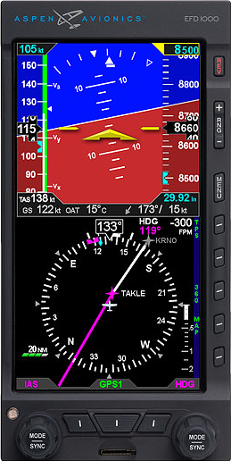
DI
AI
EFD 1000
ASI
ALT
BN-2A Modified Configuration

Slide 30
AI
DI
EFD 1000
ASI
ALT
BN-2A Final Configuration

Slide 31
Is this a dual installation?
IRS
IRS
FMS
CDU
CDU

Slide 32
IRS
IRS
FMS
ANCDU
ANCDU

Slide 33
RVSM or not RVSM? – Dents & Buckles

Slide 34
PFOV
RAD
ENG
GNSS
ASI
AI
ALT
ENG
GNSS
Turn Coordinator
DI
VSI
Transponder
ENG
GNSS Annunciator View

Slide 35
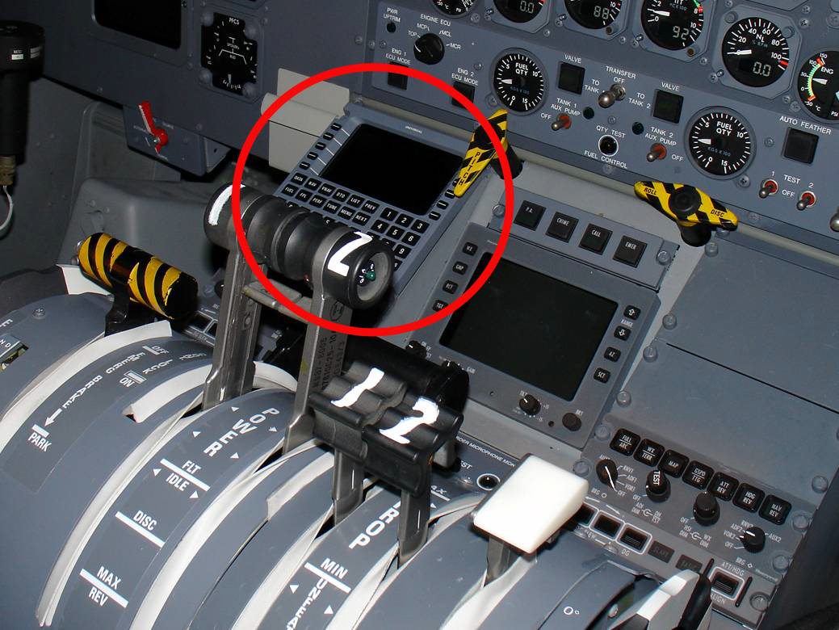
Visibility & Accessibility (Q300)

Slide 37
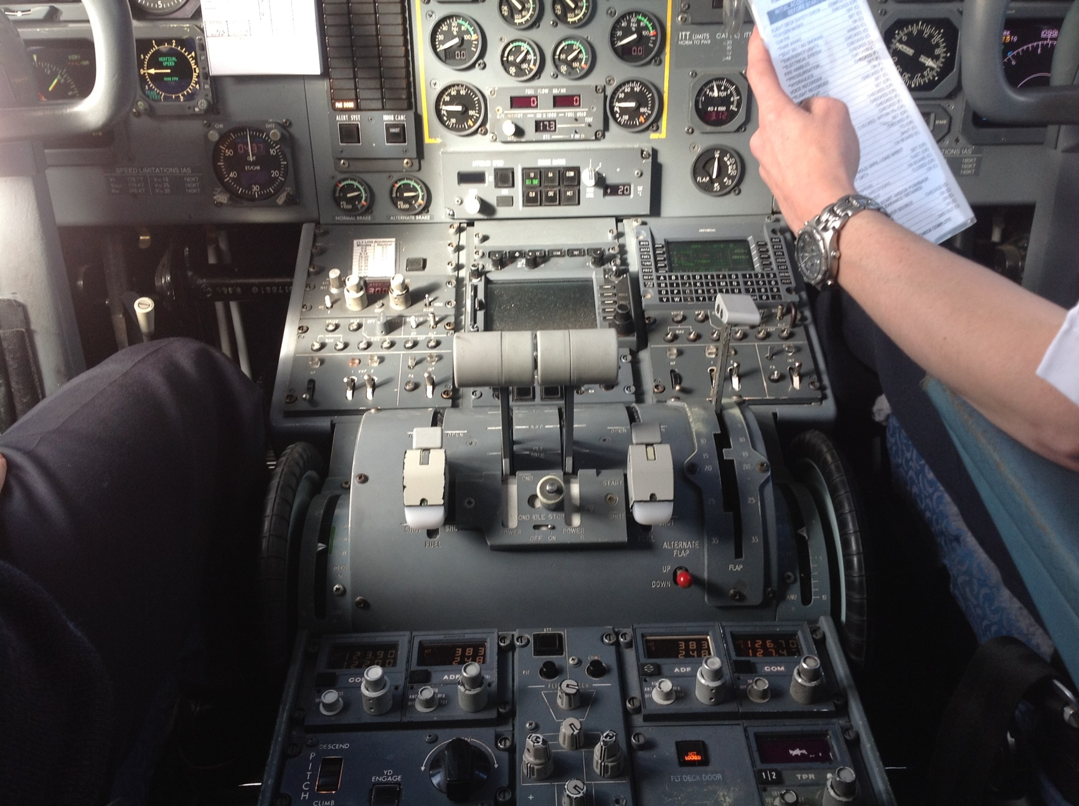
Visibility & Accessibility (F50)

Slide 38
Electrical Load Analysis
Many GA aircraft struggle to meet the ELA requirements.
CAR 3B has no 30 minute battery only requirement.
Some GA manufacturers use a 30 minute discharge rate for the ELA rather than the 1 hour rate of SAE F2490-05.
This provides a 1.8 benefit over the 1 hour rate.
Battery is flat after 10 – 15 minutes compared to SAE F2490-05.

Slide 39
ELA Mitigation
10 minute generator recognition period reduced to 5 minutes with flashing annunciators in the PFOV.
No recognition period for automatically shed loads.
All non-essential loads turned off – AFM supplement may be needed for electrical power failure.
Manual control of high power loads to minimise consumption e.g. de-icers.
Lightest load of navigation lights and strobes used.
Landing lights limited to 2 minutes prior to landing.

Slide 40
RNP AR Operations
Application received for RNP AR operations to Queenstown.
Aircraft owned by high wealth individual.
Aircraft is modified to equip it with the required systems – not OEM or STC approved.
No RNP AR approval in the AFM.
Flight test data is presented to demonstrate compliance:
Flight test plans have not been reviewed or accepted by a Regulator.
No evidence RNP AR of crew training.

Slide 41
Air Route and Aircraft
Nominated RNP X air route
What are the aircraft requirements?
Different aircraft have different default RNP
Need for pilots to set required RNP level
Some are still RNP 12!

Slide 42
QUESTIONS and DISCUSSION

